Slide 1
Anxiety

Slide 2
The Facts
Anxiety is a feeling of worry, nervousness, or unease
An anxiety disorder is excessive amounts of worry, nervousness or dread that occurs on a regular basis.
Anxiety disorders are the most common mental illnesses in the U.S.
Affects 31.9% of U.S. adolescents (13-18)
The 5 major types of anxiety disorders:
Social Anxiety Disorder
Post-Traumatic Stress Disorder (PTSD)
Generalized Anxiety Disorder (GAD)
Panic Disorder
Obsessive-Compulsive Disorder (OCD)
Notes:
Additional disorders are, separation anxiety and specific phobias

Slide 3
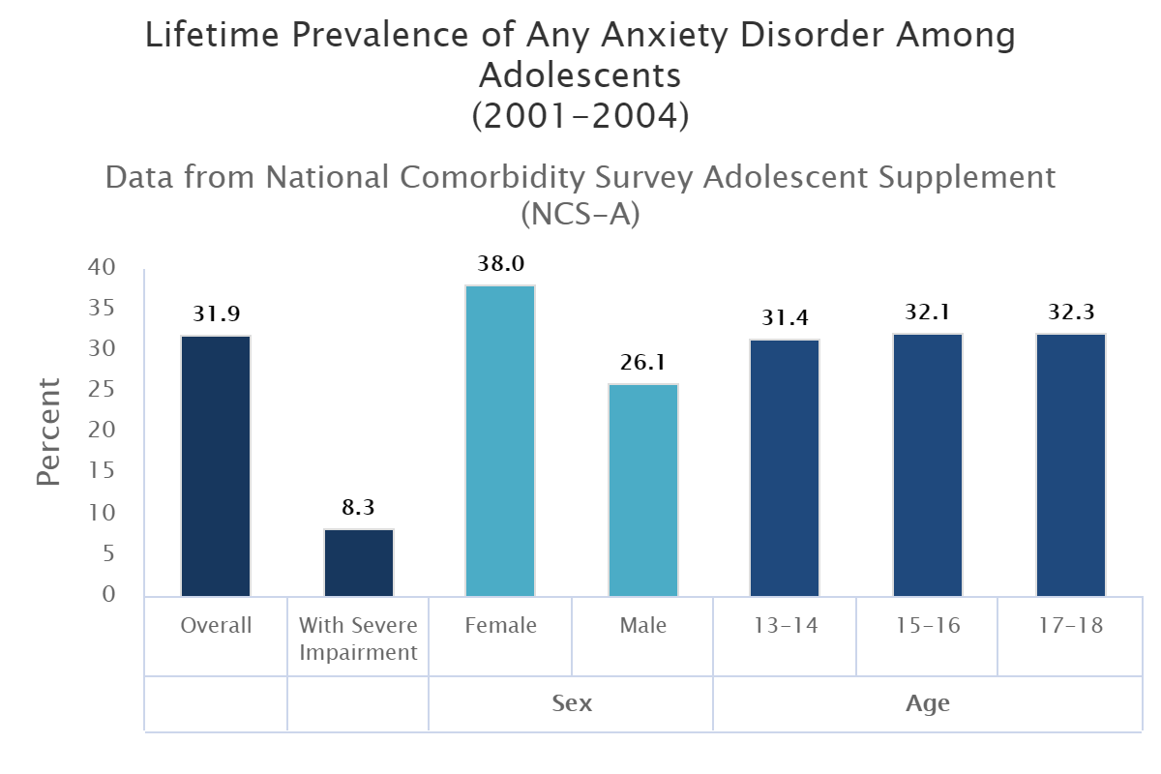
Lifetime Prevalence of Any Anxiety Disorder Among Adolescents (2001 – 2004)
https://www.nimh.nih.gov/health/statistics/any-anxiety-disorder.shtml

Slide 4
Social Anxiety Disorder
Affects 9.1% of adolescents
Fear of social or performance situations
Symptoms:
Feeling highly anxious
Feeling very self-conscious
Worried about being humiliated, embarrassed, or rejected
Afraid of judgment from others
Blushing, sweating, or trembling around others
Feeling nauseous or sick when others are around
Staying away from places with other people

Slide 5
Generalized Anxiety Disorder
Affects 2.2% of adolescents
Girls are twice as likely to be affected
Symptoms:
Muscle tension
Headaches
Stomachaches
Restlessness and fatigue
Excessive worrying
Avoid social activities
Overwhelmed
Trouble concentrating
Irritability

Slide 6
Causes
Specific causes are unknown
Complex set of risk factors:
Brain chemistry
Personality
Life events
Treatments
Only about 1/3 of adults and children with anxiety disorders seek treatment
Can be treated with:
Therapy
Cognitive-Behavorial Therapy
Medication
Notes:
CBT-focuses on identifying, understanding, and changing thinking and behavior patterns

Slide 7
Tips for Teachers
Talk with your student about their individual worries/stresses/triggers
Allow them to briefly leave a situation
Get a drink of water
Go to a “safe” place
Walk through the hall
Testing conditions:
Extended time on tests
Word banks, Equation sheet
Homework expectations:
Reasonable due dates
Manageable work load
Think-Pair-Share
Notes:
http://understandinganxiety.wayahead.org.au/download/strategies-to-support-anxious-children-in-the-classroom/?wpdmdl=1669

Slide 8
Tips for Teachers cont.
Let students know the schedule in advance and timely notify them of schedule changes
Refrain from telling a student:
Stop worrying
You’ll be fine
You’re overreacting
Let students know the schedule in Validate their feelings
“I can see you’re very worried about this assignment”
Notes:
http://understandinganxiety.wayahead.org.au/download/strategies-to-support-anxious-children-in-the-classroom/?wpdmdl=1669

Slide 9
References
U.S. Department of Health and Human Services. What are the five major types of anxiety disorders?, 12 Feb. 2014, https://www.hhs.gov/answers/mental-health-and-substance-abuse/what-are-the-five-major-types-of-anxiety-disorders/index.html Accessed 22 Feb. 2018.
Anxiety and Depression Association of America. Treatment, n.d., https://adaa.org/finding-help/treatment. Accessed 6 March 2018.
National Institute of Mental Health. Anxiety Disorders, March 2016, https://www.nimh.nih.gov/health/topics/anxiety-disorders/index.shtml. Accessed 6 March 2018.
Way Ahead-Mental Health Association NSW. Small Steps Strategies to Support Anxious Children in the Classroom. 2001. PDF. http://understandinganxiety.wayahead.org.au/education/strategies-to-support-anxious-children-in-the-classroom/ Accessed 9 March 2018.

